Slide 1

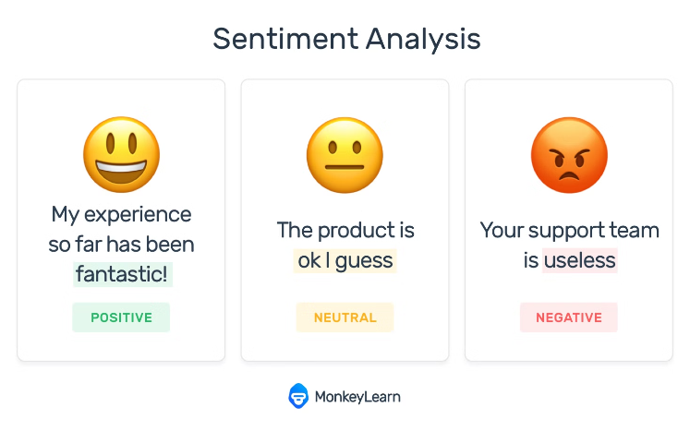

Leveraging Reviews to Understand Consumer Sentiments

Slide 2






Meet the Team
Odele Pax
Christian Leon
Angelica Calderon
Vanessa Wright
Leigh Nash
Ramona Ciobanu

Slide 3
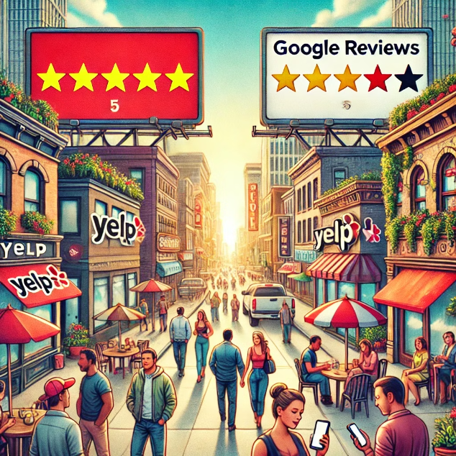
PROJECT OVERVIEW:
Our team explored the hypothesis that detailed sentiment analysis on business reviews can provide actionable insights into customer satisfaction and service quality across various businesses.
Reviews were used to both classify sentiments as positive😀, neutral😑, or negative🤬, and to generate dynamic feedback. With a combination of a Transformer-based sentiment analysis and Natural Language Processing, we can offer insights and recommendations to potentially help businesses tailor their services more effectively and meet consumer expectations.

Slide 4
Data Overview/Handling:
The project utilizes the Yelp Open Dataset, which consists of several JSON files detailing businesses, reviews, user engagements, and check-ins. The raw data underwent extensive cleaning and preprocessing. We removed unnecessary columns and handled missing values to ensure dataset integrity. Text data from reviews was processed for NLP tasks, which included tokenization. EDA was conducted to understand the underlying patterns and distributions within the data. We visualized the distribution of ratings, review counts, and business categories. Specific datasets included:
Business Dataset: Contains details like location, attributes, and categories of various businesses.
Reviews Dataset: Consists of full review texts along with user and business IDs, ratings, and timestamps.

Slide 5

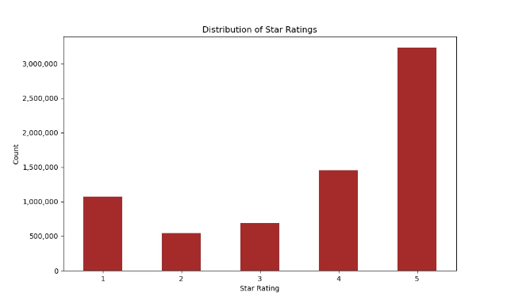
Visualizations:
Ratings Distribution: Shows how the ratings are distributed, providing insights into general customer satisfaction.

Slide 6

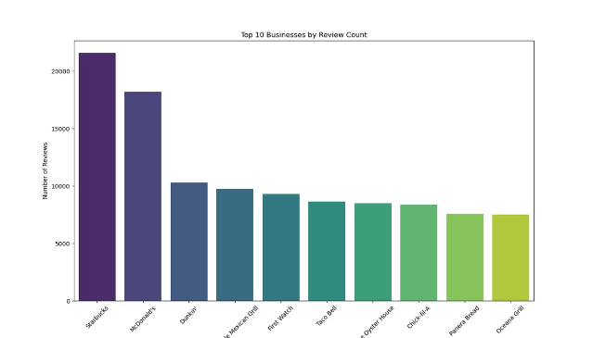
Visualizations Cont.
Ratings Distribution: Top 10 Businesses by review Count. With Starbucks taking the lead.

Slide 7

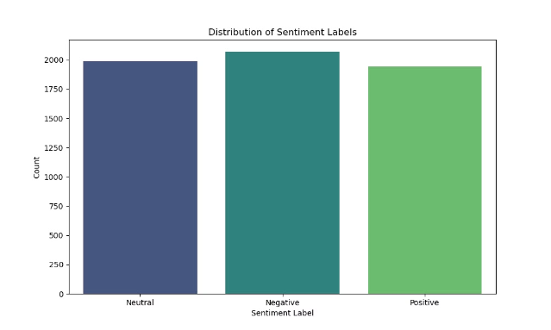
Visualization Cont.
Distribution of Sentiment Labels: While the distribution of neutral, negative and positive reviews look similar, it is clear that people are more likely to leave a review with a negative sentiment.

Slide 8
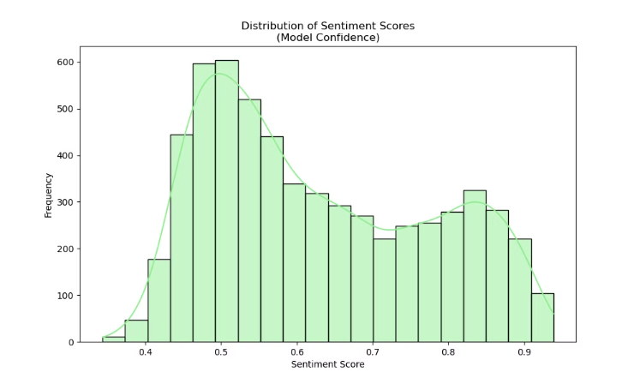
Visualization Cont.
Distribution of Sentiment Scores: This indicates the confidence score that the model is outputting per each sentiment given.

Slide 9
Data Handling:
Loading and Merging: Business and reviews datasets are merged based on business IDs to correlate with unique business reviews.
Cleaning: Unnecessary features (such as user_id, is_open, attributes, etc.) are dropped to focus on essential variables.
Preprocessing: Reviews text is cleaned and preprocessed for analysis. Missing values in crucial columns are addressed either by imputation or removal.

Slide 10
Model Setup & Evaluation:
Evaluating trained models using testing data is a critical step in the model development process, ensuring that the models perform well on unseen data, which simulates how they would perform in a real-world scenario.
Data Splitting: Initially, data is split into training and testing sets, with the testing set reserved solely for final evaluation to mimic real-world application.
Training: The model is trained on the training dataset, involving text preprocessing, feature extraction, and learning based on sentiment labels.
Testing: The testing data is then used to assess the model's performance. This data has not been seen by the model during training, ensuring the evaluation reflects potential real-world performance.
Evaluation Metrics: Various metrics such as accuracy, precision, recall, and F1-score, helped us understand how well the model is predicting and where it may be making errors.
This process ensures the model is not only accurate but also robust and reliable, ready for practical application. In the end our model performed with an accuracy of ~82%.

Slide 11
The Transformer
We tested several Bert and pipeline models, such as HeBert (traied in Hebrew) and ALBERT. We changed from DistilBert to MarieAngeA13/Sentiment-Analysis-BERT and then back to DistilBert, as it is a Bidirectional Encoder Representation from Transformers, and most suitable for our task. The models were evaluated using both validation and testing datasets, and we used metrics such as accuracy, precision, recall, and F1-score to inform decision making during hyperparameter tuning.

Slide 12
The Web Scraper
The web scraping process uses Selenium and BeautifulSoup to extract business and review data from Google Maps. Selenium navigates to business URLs from a CSV file, and BeautifulSoup parses details like names, ratings, and addresses after accessing the Reviews tab. The script also scrolls through and expands reviews to capture complete data, which is then compiled into Pandas DataFrames for each business and combined into a single structured dataset for frontend development.

Slide 13
The LangChain
LangChain was integrated using the OpenAI GPT-3.5-turbo model to analyze business reviews. The process involves formatting review data into prompts using a PromptTemplate and processing these through an LLMChain. This setup enables the generation of concise summaries and actionable recommendations from the reviews, effectively leveraging AI to extract valuable insights from customer feedback.

Slide 14

The App
SpooderApp™ was built using Dash, creating an interactive web app that analyzes customer reviews to provide business insights. The app features a responsive interface with dropdowns, dynamic maps, and accordion-based sentiment analysis, all styled using Bootstrap components. Dash's callback system ensures real-time updates, making it an ideal framework for developing this data-driven application.

Slide 15
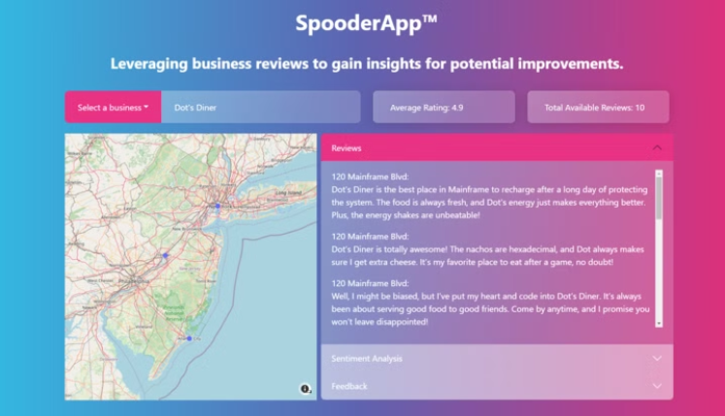
Meet SpooderApp™
Powered by roberto and davidlingo

Slide 16
Future Enhancements:
If more time allowed, future enhancements may consist of the following:
We can consider expanding the model to handle reviews in multiple languages (M-Bert), reflecting Yelp's diverse global user base, which would make our application more versatile and accessible.
We can also integrate predictive models to forecast future review trends or business performance based on current sentiment scores and other variables like location or time of year.
Developing customizable dashboards where businesses can track their reviews and sentiment trends over time. Improving the interactivity of the web application with features like voice commands or chatbots that could guide users through the data exploration process.
Allow for ad hoc searches of businesses and real-time web scraping.
Retrieve a complete list of available reviews in lieu of the sampled up-to-fifty.
Train roberto on a larger dataset than the six thousand (6,000) reviews provided.
Final application to be deployed to a web server, making it accessible for real-world use.

Slide 17
Key Results:
Sentiment Classification Accuracy:
Our final model, roberto, achieved a high level of accuracy (over 82% accuracy) in classifying sentiments as positive, negative, or neutral.
Actionable Feedback:
Our OpenAI LangChain, davidlingo, effectively summarizes available reviews and provides consumer-driven recommendations for improvements to operations, regardless of business scale.
User Engagement and Interaction:
The deployment of the sentiment analysis model into a Dash web application allowed users to interactively explore data. Feedback from user sessions can highlight the application's utility in providing immediate sentiment insights, which can be particularly useful for business owners and managers.

Slide 18



Slide 19
Conclusions:
Practical Implications for Businesses:
The sentiment analysis tool offers a practical means for businesses to monitor and improve their customer service by addressing the areas that significantly impact customer satisfaction.
By integrating sentiment analysis with their customer relationship management (CRM) systems, businesses can proactively manage their reputations and enhance customer loyalty.
Enhancements in Customer Experience:
The analysis provides insights that can help businesses tailor their services or products to meet the expectations of their customers more effectively.

Slide 20

Closing Thoughts…

